Slide 1
Customer Rentation Project
Name: Pratyush Ghosh
Internship: 23

Slide 2

What’s Customer Rentation
Customer retention is a metric that measures customer loyalty, or the ability for an organization to keep its customers over time. In addition to identifying the number of loyal customers, customer retention can reflect or predict customer satisfaction, repurchase behavior, customer engagement and emotional ties to a brand.
While customer relationships typically begin with an initial interaction, customer retention metrics are related to the first purchase made by a customer and include all subsequent interactions. Once customer retention is measured, organizations can use this feedback to perform data analysis on components of customer experience and customer success. For example, if a drop in customer retention is reported, an organization can use this to help identify the root cause and adjust its product offerings.

Slide 3
Why is customer retention important
If an organization does not focus on customer retention but instead focuses solely on expanding its customer base, it is potentially losing out on repeat customers. While the process of gaining new customers, or customer acquisition, is important, it is also much more expensive. Maintaining customers and transitioning them into recurring customers is just as important of a process as gaining new ones.

Slide 4
Customer retention strategies
Offer personalized service. Personalizing services to the customer can improve a customer's experience and lead them to become repeat customers.
Use data to provide personalized support interactions. Data gathered about customers can help aid organizations in knowing their preferences, enabling them to build more personalized services.
Build trust. Building relationships with customers will help increase brand loyalty and trust.
Use social media. Social media sites such as Twitter, LinkedIn and Facebook can help an organization reach out to its customers, build relationships and trust, and even respond to customer support queries.
Incentivize loyalty. This can be done through customer loyalty programs or by offering discounts or credit.

Slide 5
Problem Statement
The online purchasing rate increasing day by day. Customers’ satisfaction is most important for any business development. The first question that comes into our mind is “What individual factors motivate a buyer to purchase online as well as restrain to purchase online?”.
Customer satisfaction has emerged as one of the most important factors that guarantee the success of online store; it has been posited as a key stimulant of purchase, repurchase intentions and customer loyalty. A comprehensive review of the literature, theories and models have been carried out to propose the models for customer activation and customer retention. Five major factors that contributed to the success of an e-commerce store have been identified as: service quality, system quality, information quality, trust and net benefit. The research furthermore investigated the factors that influence the online customers repeat purchase intention. The combination of both utilitarian value and hedonistic values are needed to affect the repeat purchase intention (loyalty) positively. The data is collected from the Indian online shoppers. Results indicate the e-retail success factors, which are very much critical for customer satisfaction.

Slide 6
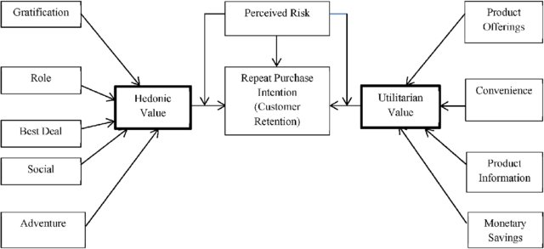
Utilitarian value: Utilitarian value is an objective value which provides some functional benefits to the consumers and helps consumers to accomplish practical tasks.
Hedonistic value: Hedonistic value is subjective (Psychological) value which provides an experiential satisfaction. In other words, the immediate psychological gratification that comes from experiencing some activity or from consumption of a product.

Slide 7
Problem Comprehension
The problem statement examined how customers form expectations on technology based self-service quality and suggested five main attributes of ecommerce store quality, that are service quality, system quality, information quality, trust and net benefit.
Many businesses focus on customer loyalty programs to remain competitive in today's marketplaces and explore innovative ways to keep their existing customers engaged. Customer retention is a simple concept. Yet, it often requires effort from every department to improve the customer experience and build lasting trust. So, what is customer retention and why it is so important. Let’s know about it by analysing the problem.

Slide 8
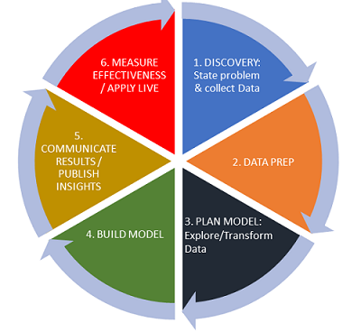
Data Analysis

Slide 9
EDA: Exploratory Data Analysis
First I have imported necessary libraries and loaded the dataset
Then checked the shape of the dataset, we are having 269 rows and 71 different columns.
We don’t have any null values in our dataset.
By checking data types we came to know that all the columns are with ‘object’ data type except the column representing the pin code of the city. I will convert it to ‘object’ type.
In column “How do you access the internet while shopping on-line?” I observed two categories, Mobile internet and Mobile Internet, which are carrying same information, so I have combined these two.

Slide 10
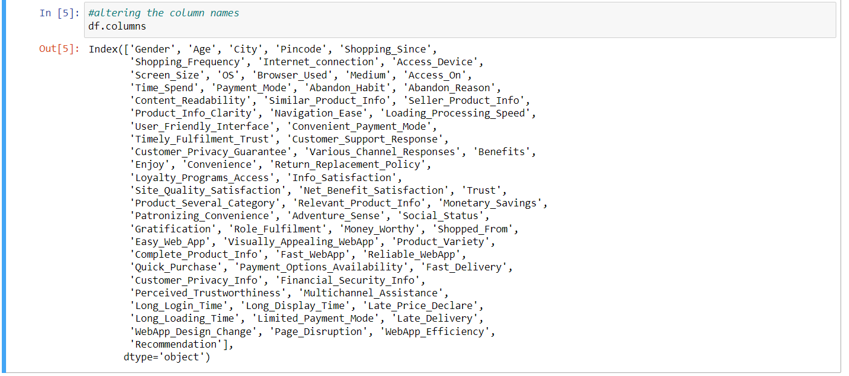
EDA
Renaming the column for better understanding:

Slide 11
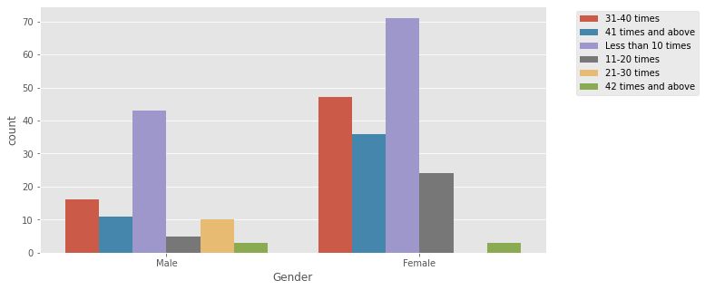
VIsulaisation
First plot represents the gender of customer, by looking at this plot we can say number of
female customers are more than males. And also female purchase more times than males.

Slide 12
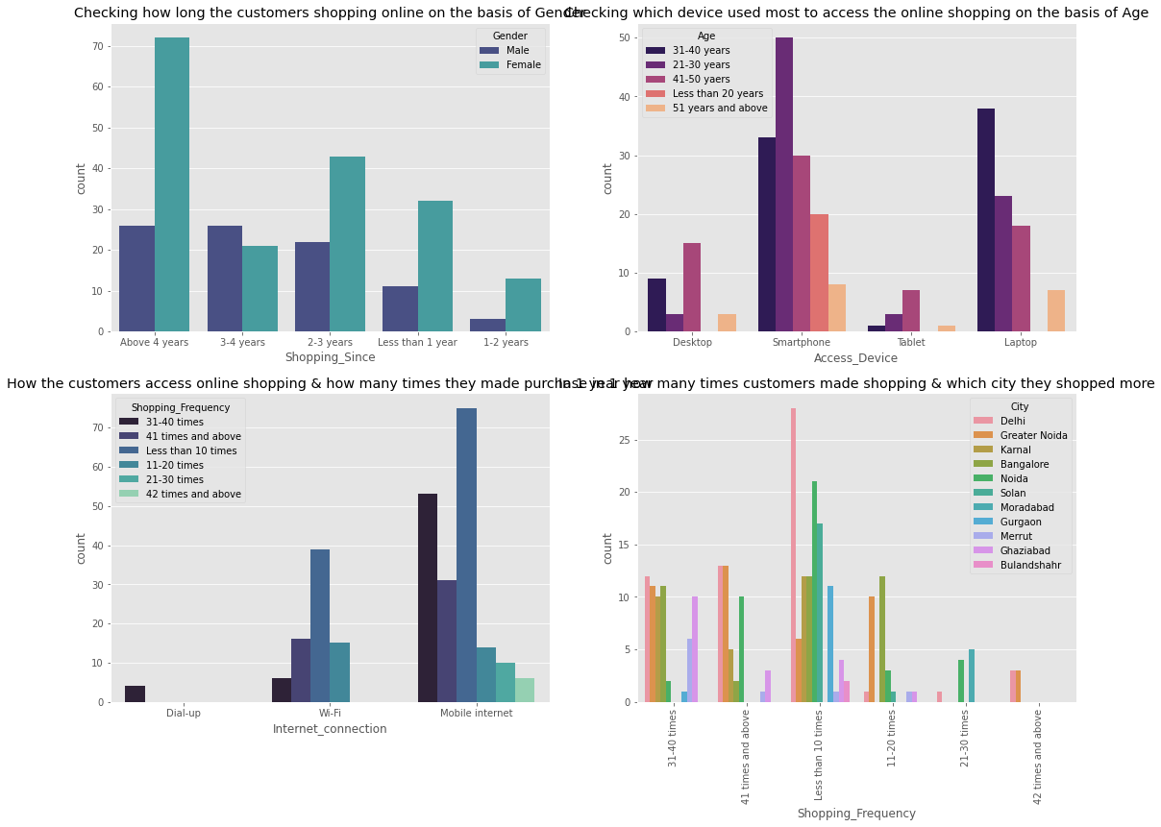

Slide 13
Scrutiny of the previous graph-1
Most of the female customers shopped online from more than 4 years and the count is also high for the females who shopped from 2-3 years. And only few male customers shop online more than 4 years. Which means the female customers are more enthusiastic to buy products from the online shopping websites.
Many customers whose age between 31-40 years and 21-30 years used Smartphones followed by Laptops to access the online shopping websites.
Most of the customers access the shopping websites more than 31-40 times in 1 year through Mobile Internet to shop the products also most of the customers who used mobile internet to access the online shopping website made online purchase less than 10 times in a year. And only few of the customers used WIFI network to access the shopping store.
Most of the customers used ecommerce websites less than 10 times in a year from the city Delhi to shop the products.

Slide 14
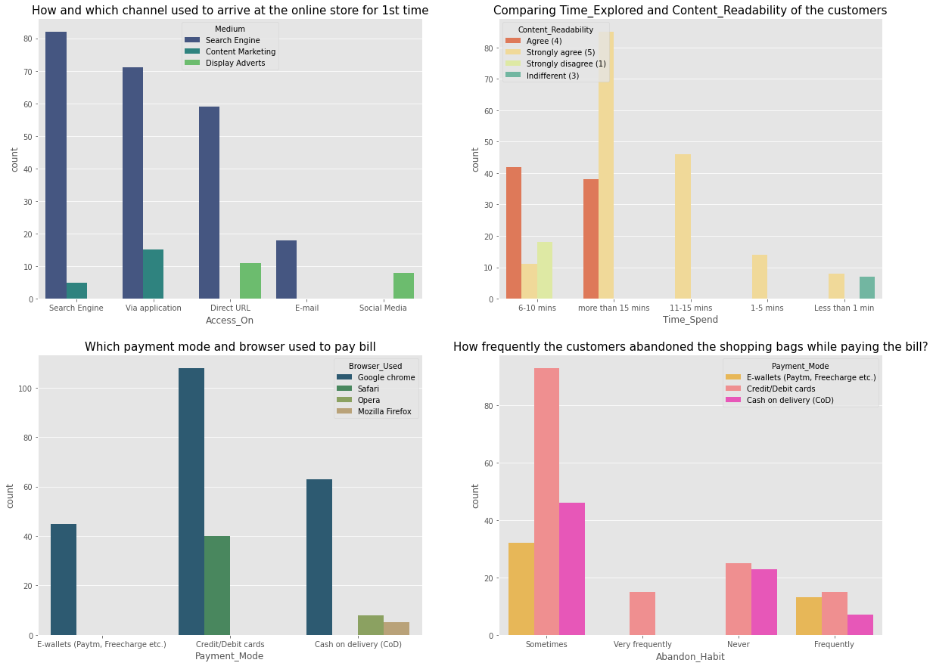

Slide 15
Scrutiny of the previous graph-2
The customers having their mobile screen size say 6 inches(others) have followed search engine channel to arrive at their favorite online store for the first time. Also the customers who have their screen size 5.5 inches also used search engine channel to access the online shopping store.
Most of the customers used Smartphones 31-40 times in an year to access the ecommerce websites to shop the products.
Many customers having windows operating system in their device ran Google chrome to access the ecommerce shopping websites and some of the customers having IOS/Mac operating system used Google chrome as well as Safari to reach the online shopping store.
Due to Lack of trust on the ecommerce websites, sometimes most of the customers abandoned the websites and some of the customers abandoned the shopping website due to the promo code not applicable. which means, if the product is having the special price or some catalogue price rule is applicable on it. Then coupon code should not be applicable on the products.
So it is important for the ecommerce companies to create discount price, offers, coupon codes to retain the customers.

Slide 16
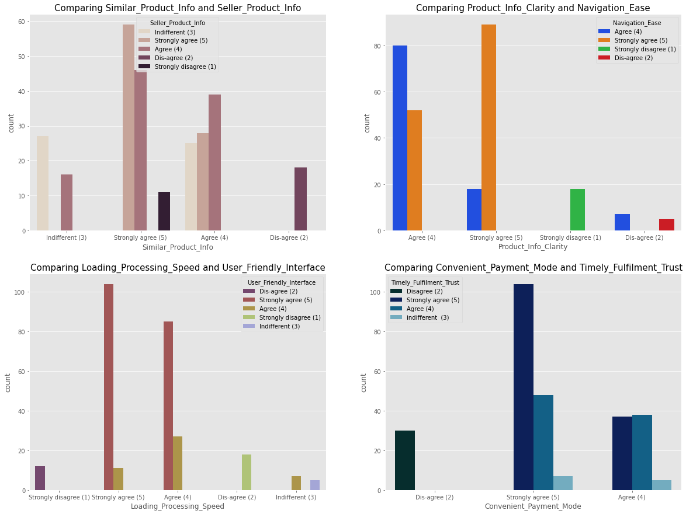

Slide 17
Scrutiny of the previous graph-3
Most customers agree that knowledge of the same product as the highlighted one is important in comparing the product and that complete information about the listed seller and the product being offered is essential for making a purchase decision. In order to purchase a product, an ecommerce website must provide complete information about the product and vendor information and only customers can compare product costs and details on different websites and usually purchase that product on a particular website.
About 90% of customers agree that they should be able to navigate the website easily and the product details on the website should be clearly stated its use, lifetime, benefits etc. Then only most customers are inclined to buy those products and can buy easily.
Most of the customers agree with an easy-to-use website that can be easily downloaded and processed and the capacity of these websites to download and process is much faster for customers to enjoy shopping on ecommerce websites. If these websites do not have much speed to load and process customers they do not want to buy products from this website and tend to other websites or alternatives.
Most of the customers agree with the belief that online stores will fulfill their part of the task in a timely manner and most of them are very happy with the simple payment methods provided by the websites. In other words, websites should provide all possible payment methods and only customers who regularly purchase a customer payment method may not always be able to opt out of cash on delivery. So if merchants offer all kinds of payment methods then customers can make payment easily and improve the sales of ecommerce sites. And the work should also be given at a set time otherwise the payments may fail so they should give the minimum amount of time that needs to be adjusted for all

Slide 18
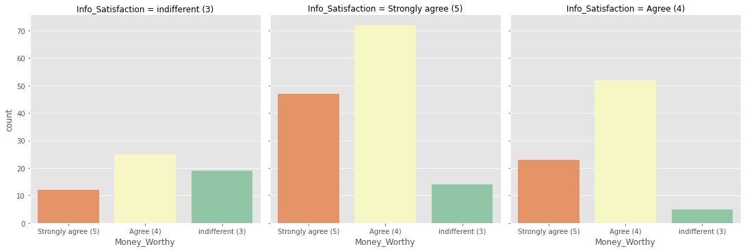
The customers should satisfy with their product that they shopped from the online store then only they agreed that
they got value for the money they spent. The companies should display the quality information about the products
so that the customers being able to purchase their product and thinks that it worth for money and this comes under
utilitarian value.

Slide 19
Conclusion
The endeavour of this study is to identify the motivating factors towards online shopping and in which e-commerce the customers likely to shop more. In this project we have investigated ecommerce quality in online businesses and develop new knowledge to understand the most important dimensions of E-retail factor for customer activation and retention.
From the analysis it was found that consumers purchasing decisions were dependent on various factors. All these motives motivate consumers to purchase products through online. According to consumers' opinions, "time saving" is the most important motivating factor for online shopping.
After visualizing the data, I found Amazon is the best online store where the customers trust on buying products and it has positive impact on the customers. Also, amazon and flip kart have increased customers’ expectations. So, they are the best online retailer who makes the loyal customers and satisfies the customers.

Slide 20
It was also observed that online shopping is not trustworthy and reliable to some consumers due to only online payment system and personal privacy. In addition, online security is a major concern for the consumer particularly in terms of fraud, privacy and hacking. So, the organizers should make up their organization for better sales.
Customer satisfaction and customer trust appeared as the outcomes of overall e-retail factor. The results of the analysis showed that e-retail factor had a positive impact on customer satisfaction

